Slide 1
ZOMATO DATA ANALYSIS
GROUP 2:
M V Yatish Sarma
B Srikanth
Abinash Lenka
Anuradha K R
Nivetha M
Ganthula Usha Rani
Samistha rath

Slide 2
Agenda
INTRODUCTION
GOAL OF THE PROJECT
DASHBOARD SCREEENSHORT
RECOMMENDATION & CHALLENGES
CONCLUSION
2

Slide 3




INTRODUCTION:
Tools used for analyzation and visualization
EXCEL
POWER BI
Zomato is a global food delivery and restaurant discovery platform. It started as an online restaurant directory and has since evolved into a leading food tech company. Currently, Zomato operates in 24 countries and serves millions of customers worldwide.
TABLEAU
MYSQL

Slide 4
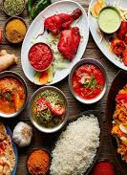
GOAL OF THE PROJECT
Main Objective:
To develop a comprehensive data model for restaurant analytics, enabling insights into customer preferences and business performance.
Key KPIs:
Total number of restaurants.
Revenue trends.
Pricing segmentation (buckets).
Delivery vs. dine-in trends.
Customer behavior insights.
4

Slide 5
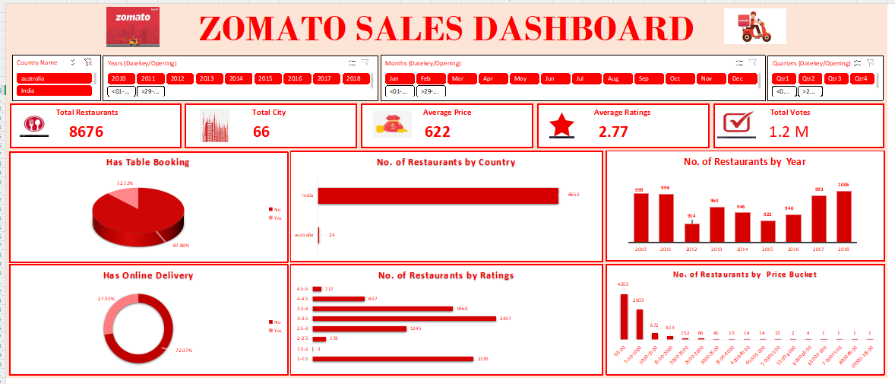
EXCEL DASHBOARD

Slide 6
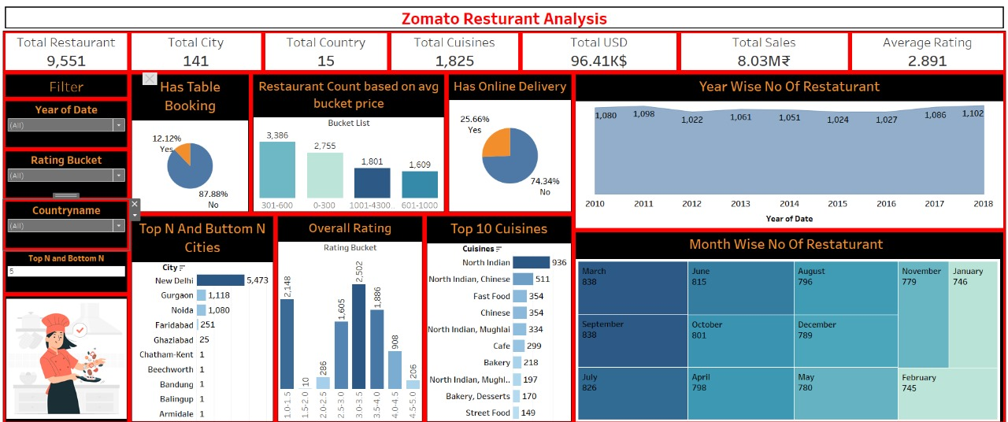
TABLEAU DASHBOARD

Slide 7
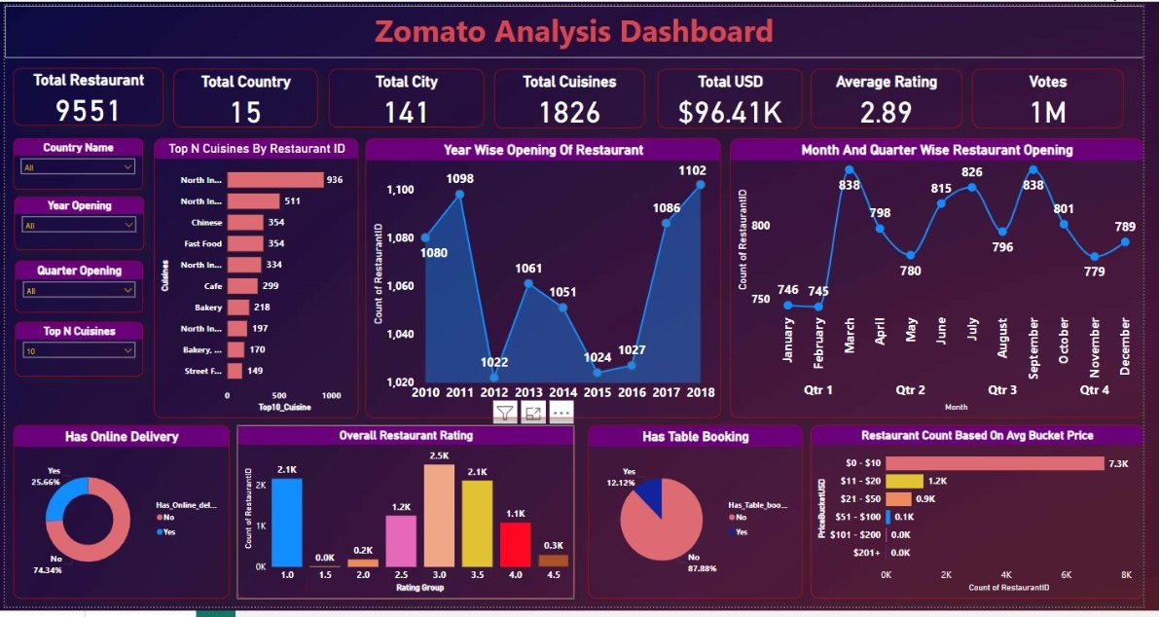
POWER BI DASHBOARD
7

Slide 8
RECOMMENDATIONS AND CHALLENGES
Challenges :
Data Cleaning: Missing or inconsistent data.
Integration Issues: Connecting multiple data sources.
Performance Optimization: Handling large datasets efficiently.
Recommendations :
Improve Data Quality: Standardize input formats.
Enhance Filtering & Segmentation: Enable advanced user interactions.
Future Enhancements: Predictive analytics for restaurant success.
8

Slide 9
CONCLUSION
Data-driven insights help in understanding restaurant growth patterns.
Pricing strategies influence customer ratings and overall satisfaction.
Table bookings show a strong correlation with revenue generation.
These findings enable decision-makers to refine strategies and enhance business performance.

Slide 10
Thank you
10

